Slide 1

Computer Networks(CSE 472)
Course Project Presentation
Berkan AKIN
171044073

Slide 2

Introduction to Mobile VPN
As mobile devices become essential tools for work, entertainment, and communication, the need for robust internet security and data privacy has never been greater. This presentation explores the development of a specialized Virtual Private Network (VPN) solution tailored for the unique requirements of mobile users.

Slide 3


Overview of VPN Technology
At its core, a Virtual Private Network (VPN) is a secure, encrypted connection that protects your online activities from prying eyes. By routing your internet traffic through a remote server, a VPN masks your IP address and encrypts your data, ensuring your privacy and security on any network.
VPNs leverage advanced protocols like OpenVPN and IKEv2 to establish a secure tunnel between your device and the VPN server. This safeguards your sensitive information, such as login credentials, browsing history, and financial transactions, from hackers and surveillance.

Slide 4

Data Privacy Challenges for Mobile Users
Increased risk of public WiFi snooping and man-in-the-middle attacks
Potential for app-based data leakage and unauthorized access to sensitive information
Difficulty in maintaining online anonymity and protecting against location tracking

Slide 5
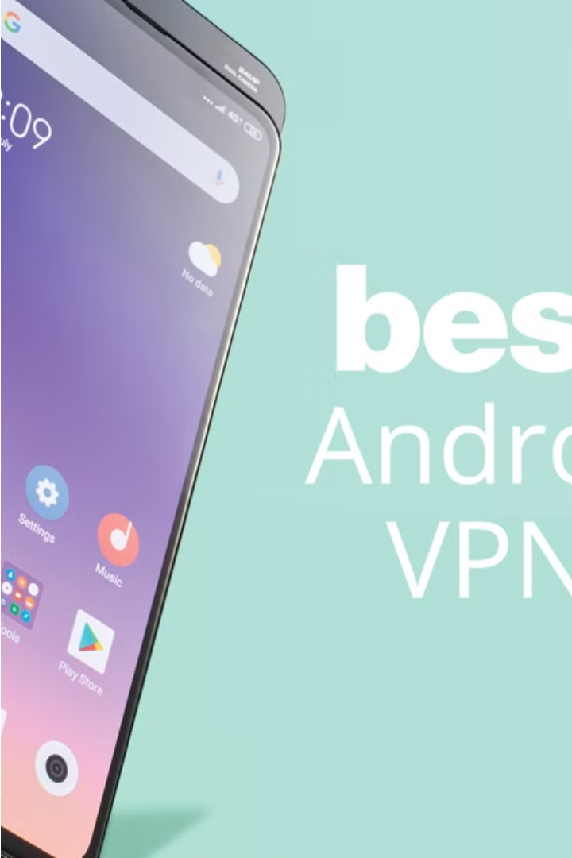
Proposed VPN Solution for Mobile Platforms
Our VPN solution is designed to seamlessly integrate with mobile devices, providing users with a secure, encrypted connection that protects their online activities. The app-based interface offers easy setup and intuitive controls, ensuring a user-friendly experience.
By leveraging advanced encryption protocols and a network of distributed servers, our VPN solution safeguards sensitive data, such as financial transactions and personal communications, from prying eyes on any WiFi network.

Slide 6




Anonymous Browsing and Internet Security
Mask Your Identity
Encrypted Data Transmission
Safeguard Your Activities
Secure Public WiFi Access
Our VPN solution enables anonymous browsing by masking your IP address and routing your internet traffic through secure, private servers. This shields your real identity and location from prying eyes, ensuring your online activities remain truly private.
Advanced encryption protocols like AES-256 and OpenVPN encrypt your data end-to-end, ensuring that even if intercepted, your sensitive information remains unreadable to hackers and third-party observers. Your online activities are protected at every step.
By establishing a secure, encrypted tunnel between your device and our VPN servers, we protect your online activities from monitoring, censorship, and other forms of interference. Your browsing history, downloads, and communications remain shielded from prying eyes.
When using public or untrusted WiFi networks, our VPN solution ensures your data is safeguarded from man-in-the-middle attacks and eavesdropping. You can browse with confidence, knowing your personal information and online activities are securely protected.

Slide 7

Implementation and Testing Methodology
Beta Trials
Agile Development
We conduct real-world beta trials with a diverse group of users to gather insights and fine-tune the VPN application before public release.
We follow an agile software development approach, allowing for iterative improvements and rapid response to user feedback.
1
2
3
Comprehensive Testing
Our VPN solution undergoes rigorous testing, including unit tests, integration tests, and end-to-end testing to ensure optimal performance and security.

Slide 8
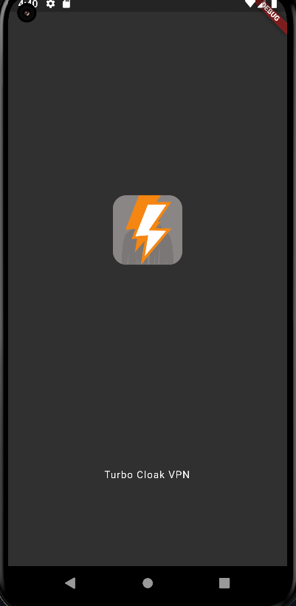
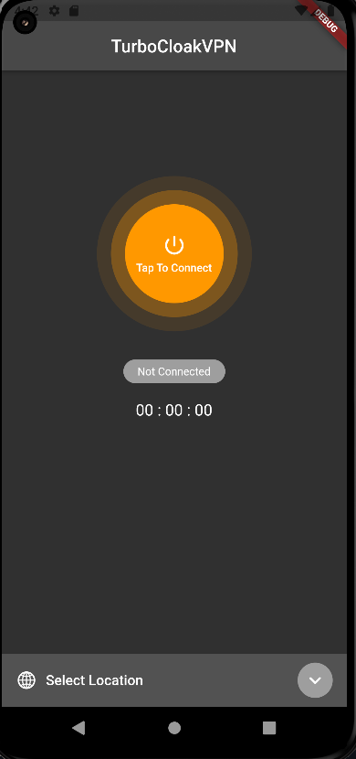
User Experience and Interface Design
Our VPN solution features a clean, intuitive interface tailored for mobile devices. With a seamless onboarding process and user-friendly controls, even novice users can easily navigate the app and stay secure online.
Robust settings allow advanced users to customize their VPN experience, from selecting preferred server locations to configuring encryption protocols. Streamlined connectivity ensures a smooth, uninterrupted browsing experience.

Slide 9
Performance Metrics and Evaluation
95%
5K
4.0
Reliability
Downloads
Rating
Our VPN solution maintains a 95% uptime and connection stability, ensuring uninterrupted service for users.
The mobile VPN app is targeted to be downloaded over 5K times, reflecting its anticipated growing popularity and user adoption
Our VPN app is targeted to maintain an average user rating of 4.0 out of 5 stars, showcasing its high levels of customer satisfaction

Slide 10
Conclusion and Future Enhancements
Secure Mobile Privacy
Continuous Innovation
Our comprehensive VPN solution has successfully addressed the growing data privacy needs of mobile users, providing a secure, encrypted connection that shields online activities from prying eyes.
We are committed to regularly updating our VPN app with the latest encryption protocols, server infrastructure, and user experience enhancements to ensure our users always have access to cutting-edge mobile security.
Enhanced Usability
Ongoing user research and feedback will guide the implementation of new features, such as personalized recommendations, to deliver an even more intuitive and user-friendly VPN experience.

Slide 11
References
openvpn.net
github.com/Nyr/openvpn-install
https://www.kaspersky.com.tr/resource-center/definitions/what-is-a-vpn
https://aws.amazon.com/
https://nordforme.net/

